Slide 1

Adventure Work Analytics Presentation
By Group 5

Slide 2
About us
Pankaj Singh
Swapnil Dalimbe
Sweta Tiwari
Srishail Patil
Vanga Bhargavi
Lissa D’monte
Nitin Kumar

Slide 3
Flow Of Presentation
Introduction
Product/Data Overview
Objectives
Analysis
Recommendations & Insights

Slide 4

Introduction
This presentation analyzes Adventure Work Cycle’s performance using a comprehensive Dashboard.
Focus areas include Sales Performance and Profitability, analyzed through various KPIs.
Data sources include historical and current data across eight tables, providing for detailed insights into product, customer, and sales trend.
Purpose: To help make better strategic decisions and find ways to improve Performance.

Slide 5
Product/Data Overview
Data Sources: Data is collected from eight tables, including Sales, Product, Customer, Category, Sales Territory, and Date.
Sales Data: Historical (Sales) and current (Sales New) data sets create a strong foundation for revenue analysis.
Product and Category Information: Detailed product and category data provides insight into sales performance by product type.
Customer Insights: Customer demographic data helps in grouping customers and analyzing their loyalty.
Geographical Scope: Regional performance data from the Sales Territory table aids territory-based strategy.
Time Dimension: The Date dimension table supports trend analysis over months, quarters, and years.

Slide 6
To analyze Sales and Profit performance
Product Wise
Region Wise
Year Wise
Monthly
Category &Subcategory Wise

Slide 7
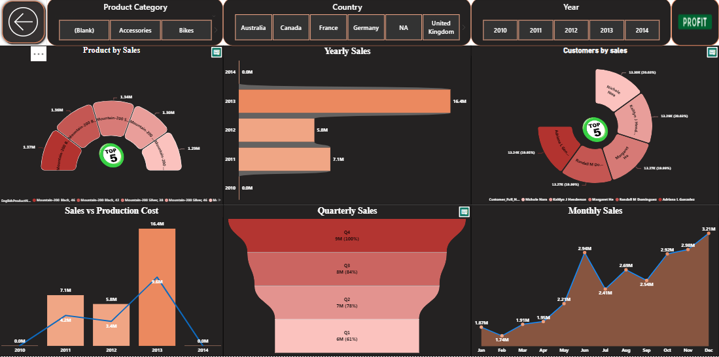
Sales Dashboard

Slide 8
Sales Dashboard Components
Total Sales
Overall revenue in all regions is 29.36M
Yearly Sales Trend
The bar chart shows yearly sales, peaking at 16.4 million in 2013. This growth indicates an increase in customer reach or product demand. However, sales dropped in 2014, highlighting the need to investigate possible reasons behind this decline.
Quarter wise
Sales Analysis Q4 leads with the highest sales of 9.1 million, while Q1 has the lowest at 5.5 million.
This helps identify the peak sales period, which is Q4, possibly indicating seasonality in the business.
Monthly Sales
Monthly sales depict a clear upward trend, with peaks in June (2.94M) and December (3.21M). This pattern suggests potential seasonal demand, possibly linked to holidays or year-end promotions that drive sales.

Slide 9
Customers by Sales
The top five customers are shown, each accounting for around 20% of sales. This close percentage distribution across the top customers indicates a diversified customer base rather than dependency on a single customer, which can be advantageous for long-term stability.
Sales vs Production Cost
The graph shows that sales outpaced production costs significantly in 2013, where sales peaked at 16.4M. This positive margin indicates high profitability in that year. However, years like 2012 and 2014 show a closer alignment between production cost and sales, which could imply slimmer margins or potential cost inefficiencies.
Monthly Sales
Monthly sales depict a clear upward trend, with peaks in June (2.94M) and December (3.21M). This pattern suggests potential seasonal demand, possibly linked to holidays or year-end promotions that drive sales.
Top 5 Product Sales
A sunburst chart shows the best-selling products, with "Mountain-200 Black" and "Mountain-200 Silver" at the top. The highest sales for a single product reach 1.37 million, indicating a popular product line. This helps with planning inventory and predicting demand for popular items.

Slide 10
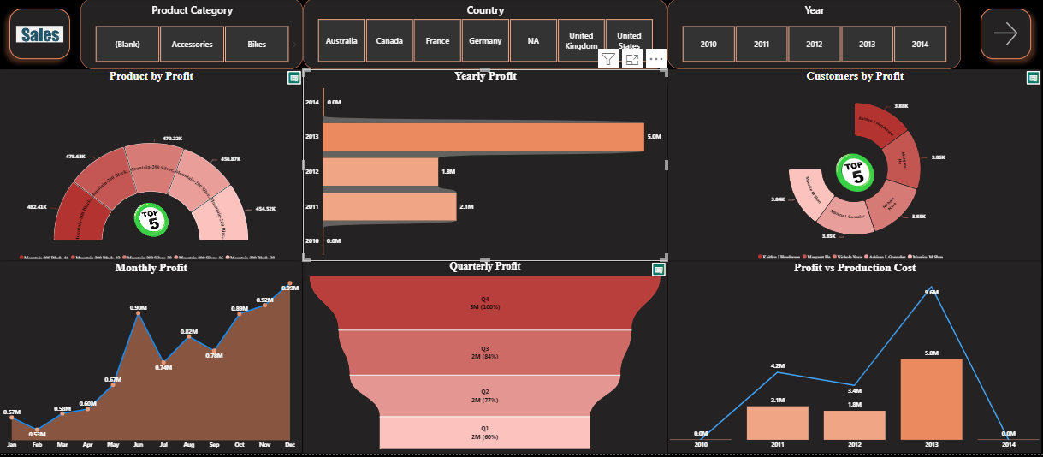
Profit Dashboard

Slide 11
Profit Dashboard Components
Total Profit
Overall profit in all Regions is 9.00M.
Top Performing Products by Profit
The top 5 profitable products are all from the Mountain-200 series, especially in black and silver colors. This shows a strong customer preference for these specific models. The highest profit is from Mountain-200 Black with 482.43K, indicating it could be a flagship product with high demand.
Customer Segmentation by Profit
The top five customers, including Kathy J. Hendersen and Margaret IK, contribute the most to the profits, each generating between 3.85K to 3.88K.Understanding the buying patterns and needs of these customers can help target similar profiles for future growth.
Quarterly Profit Breakdown
Q4 contributes the highest profit at 3M (100%), indicating a surge in sales towards the end of the year, likely due to holiday season demand. Other quarters, especially Q1 with only 60% of the target, show room for improvement. Focusing on marketing efforts in Q1 could help smooth out the profitability across the year.

Slide 12
Monthly Profit Growth
There is a steady upward trend in monthly profit, peaking in June (0.9M) and November (0.92M), which aligns with peak sales seasons. The gradual rise in profit suggests successful incremental strategies, with possible seasonal influences boosting certain months.
Profit vs. Production Cost
The production cost peaked in 2013 at 5M, aligning with the highest profit year, which implies an efficient production scale-up to meet demand. Years like 2010 and 2014 show minimal production costs, which could indicate lower demand or optimized processes that reduced production expenditures.
Overall Profit Analysis
The yearly profit chart shows that 2013 was the most profitable year with 5M, followed by 2011 with 2.1M and 2012 with 1.8M.This trend suggests significant growth in 2013, which could be due to successful product launches, strategic promotions, or other impactful business decisions.

Slide 13
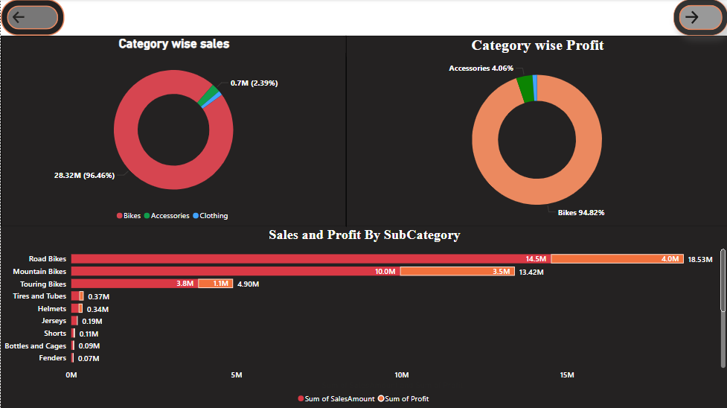
Category wise dashboard

Slide 14
Category-wise Sales Distribution
Bikes account for 96.46% of total sales (28.32M), with Accessories at 2.39% (0.7M) and Clothing contributing very little. This shows that Bikes are the main source of revenue, so keeping them high quality and ensuring customer satisfaction is essential.
Category-wise Profit Contribution
Bikes also lead in profitability, contributing 94.82% of total profit, while Accessories account for just 4.06%. This strong profit alignment with sales makes Bikes the key focus for maximizing both revenue and profit.
Subcategory Sales and Profit Breakdown
Road Bikes: Highest sales (18.53M) and profit (4.0M), indicating strong demand and high margins.
Mountain Bikes: Sales of 10.0M and profit of 3.5M, making it a significant contributor. Touring Bikes: Sales at 3.8M with a profit of 1.1M, showing decent margins.
Accessories: Items like Tires and Tubes (0.37M), Helmets (0.34M), and Jerseys (0.19M) contribute minimal sales and profit but can add value as complementary items to bike purchases.

Slide 15
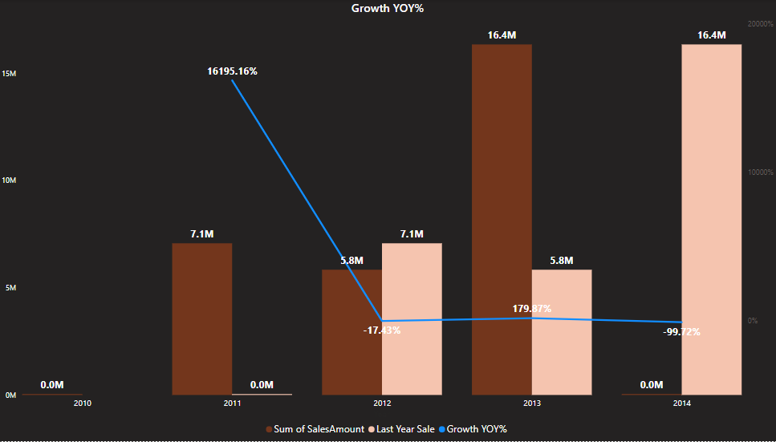
Growth YOY%

Slide 16
2010 Sales
The business started in December 2010, achieving total sales of 43,421.03. This low initial sales figure set the stage for significant growth in 2011.
2011 Growth Spike
In 2011, sales skyrocketed from 43,421.03 to 7.1M, resulting in a remarkable growth rate of 16,195.16%. This reflects rapid expansion during the early stages.
Decline in 2012
Sales fell from 7.1M in 2011 to 5.8M in 2012, leading to a -17.43% growth rate, indicating market challenges after the initial growth.

Slide 17
Recovery in 2013
In 2013, sales rebounded to 16.4M, representing a 179.87% increase from 5.8M in 2012, marking a strong recovery.
2014 Incomplete Data
In 2014, only January sales of 45,694.72 were recorded, resulting in a misleading -99.72% growth rate due to incomplete data.
Overall Trend
The chart shows extreme fluctuations in growth percentages, with significant increases in 2011 and 2013, alongside declines in 2012 and 2014 (affected by incomplete data). This volatility is typical for a new business finding its footing.

Slide 18
Recommendations
1. Stock top-selling products like "Mountain-200" models.
2. Replicate 2013’s successful strategies.
3. Run seasonal promotions in peak months.
4. Reduce production costs in leaner years.
5. Expand engagement with smaller, growth-potential accounts.

Slide 19
Insights
Certain features drive "Mountain-200" popularity.
2. Sales peak in Q4 and holiday months.
3. High margins in 2013 highlight cost control benefits.
4. Broad customer base adds stability.
5. December’s demand boost offers promo opportunities.

Slide 20
Conclusions
Focus on best-selling products for steady growth.
2. Leverage peak sales months and successful past strategies.
3. Control costs to maintain profit in lower-sales years.
4. Diversified customer base supports stability.
5. Maximize seasonal sales with targeted promotions.

Slide 21


